Slide 1
Module Import & Introduction to Time Module

Slide 2
Objectives
This chapter introduces:
Introduction to module
Import module in a file
Time module and the functions of the time module

Slide 3
Module
A module is a file containing Python definitions and statements
The file name is the module name with the suffix .py appended
Definitions from a module can be imported into other modules or into the main module
Users can define a module by themselves
Use the 'import' keyword to import the module and call the functions provided in the module

Slide 4
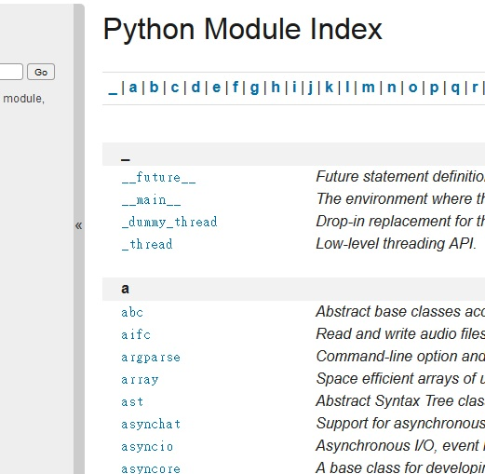
Standard module
When Python is installed, the standard library of Python language is also installed
The standard library contains hundreds of modules that provide tools for interacting with the operating system, interpreter, and Internet
The information of the standard module: https://docs.python.org/3/py-modindex.html

Slide 5
time module
time: One of Python's standard library modules
Including functions related to access time
The functions of the time module include: -- Get the current date and time -- Get a specific time zone -- Pause the program -- ............

Slide 6
time module
Use the 'import' keyword to import the module and call the function defined in the module
import time #import the time module
input('Press enter to start timing :')
starttime = time.time() #A function provided by the module
#Return the number of seconds that have passed since January 1, 1970
input('Press enter to stop timing :')
endtime = time.time()
print ('Elapsed time (seconds) ：' + str(endtime - starttime))

Slide 7
time module
time.clock() -Return the floating point number of seconds that have elapsed since the first use of this function
time.gmtime() -Return the current time in UTC time zone
time.localtime() -Return the current time in the system time zone
time.sleep(secs) -Suspend execution of the calling thread for the given number of seconds
time.time() -Return a floating point number of seconds elapsed from January 1, 1970 to the present
time.timezone () -The number of seconds between the system time zone and UTC time zone

Slide 8
time module
time.strftime(string, [, t])：
Convert a tuple or struct_time representing a time as returned by gmtime() or localtime() to a string as specified by the format argument
If t is not provided, the current time as returned by localtime() is used.
%H | Hour (24-hour clock) [00 ~23]
%I | Hour (12-hour clock) [01 ~12]
%M | Minute [01 ~ 12]
%S | Second [00 ~ 59]
%Y | Year (AD)
%m | Month [01 ~ 12]
%B | Month [English]
%d | Date [01 ~ 31]
%p | ‘AM’ (morning) or ‘PM’ (afternoon)
others | https://docs.python.org/3/library/time.html#time.sleep
time.strftime('%B')
Return the string "July"
time.strftime('%M:%S')
Return the string "53:17"

Slide 9
time module
>>> from time import gmtime, strftime
>>> strftime("%a, %d %b %Y %H:%M:%S +0000", gmtime())
'Thu, 28 Jun 2001 14:17:15 +0000'
%H | Hour (24-hour clock) [00 ~23]
%I | Hour (12-hour clock) [01 ~12]
%M | Minute [01 ~ 12]
%S | Second [00 ~ 59]
%Y | Year (AD)
%m | Month [01 ~ 12]
%B | Month [English]
%d | Date [01 ~ 31]
%p | ‘AM’ (morning) or ‘PM’ (afternoon)
others | https://docs.python.org/3/library/time.html#time.sleep

Slide 10
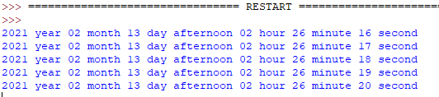
time module
import time
while 1:
period = time.strftime('%p')
if period == 'AM':
print(time.strftime(‘%Y year %m month %d day morning %I hour %M minute %S second'))
else:
print(time.strftime(‘%Y year %m month %d day afternoon %I hour %M minute %S second'))
time.sleep(1) #Pause for 1 second

Slide 11
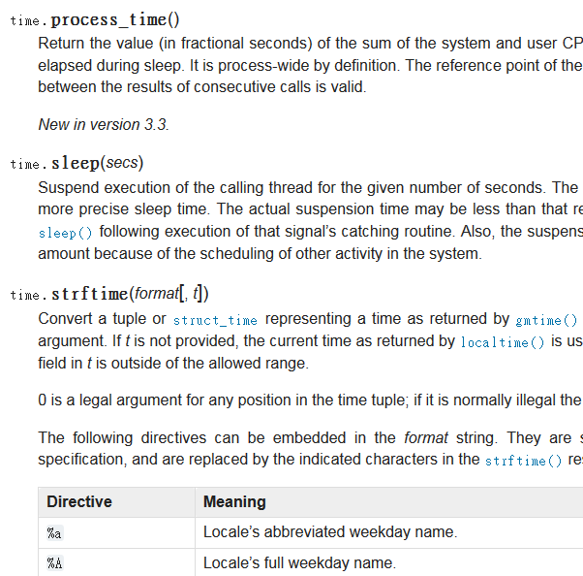
Standard module
The official Python documentation provides an introduction to each module and how to use the module.
The official documentation of the time module :
https://docs.python.org/3/library/time.html

Slide 12
Sources
References:
https://docs.python.org/3/py-modindex.html
https://docs.python.org/3/library/time.html
深入淺出程式設計(Head First Programming)(2011) .

Slide 13
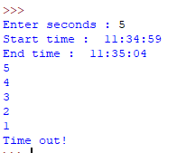
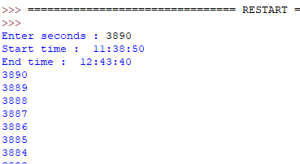
Exercise 1
Design a countdown timer that will ask the user to enter the number of seconds, and then show the present time and end time by the inputted number. After this, the timer will output the remaining time on the screen every second, until the remaining time is zero.
Output example: Enter 5: Enter 3890:

Slide 14

Exercise 2
Write a program to get the current time and check if it is a leap year or not.
Output example:
Year

Slide 15
Exercise 3
Write a program to ask the user to enter a specific date, and then display which day of the week it is
Input:
2021/02/21
Output:
Sunday

Slide 16
Exercise 4
Write a program that will load English words from english.txt and show the words one by one. For each of the appeared words, the user has to type the same word on the screen. If the word inputted by the user is not the same with the appeared word, the program will ask the user to input the data again, until the inputted word is the same with the appeared word. After all words in english.txt are appeared, the program has to show the time that is wasted by the user to input the data.

